Slide 1

Using Ansible and PowerShell Together
@JONATHANMEDD
@PSSOUTHAMPTON

Slide 2

What is Ansible?
Ansible is an open-source software provisioning, configuration management, and application-deployment tool.
The name refers to the fictional instantaneous hyperspace communication system "ansible"
Ansible, Inc. (originally AnsibleWorks, Inc.) was the company set up to commercially support and sponsor Ansible. Red Hat acquired Ansible in October 2015

Slide 3
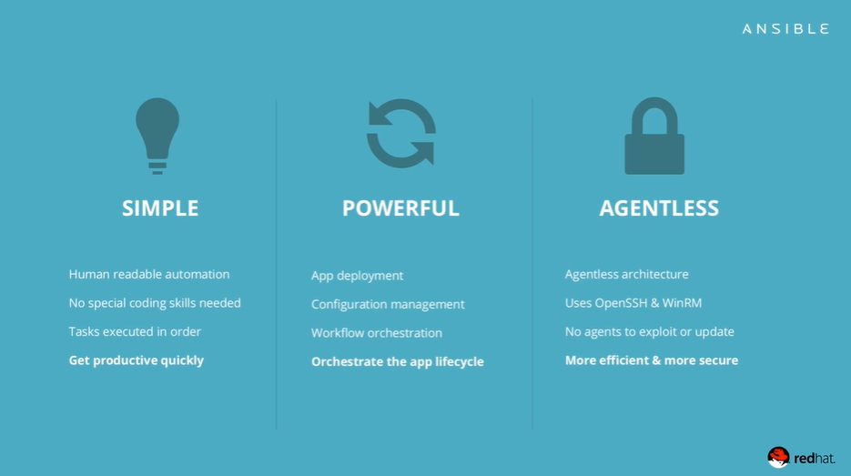
Intro

Slide 4
Agentless
In contrast with other popular configuration-management software — such as Chef, Puppet— Ansible uses an agentless architecture
Instead, Ansible orchestrates a node by installing and running modules on the node temporarily via SSH or WinRM

Slide 5
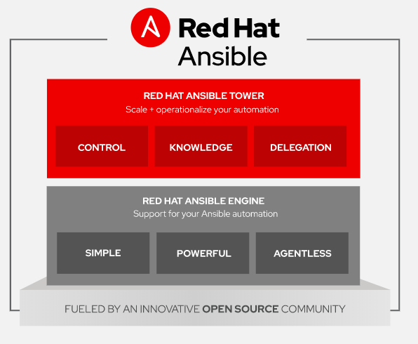
ANSIBLE versions
Ansible Engine – Opensource
Ansible Tower – Enterprise Framework
Brings GUI / REST API / Red Hat support
AWX – Opensource version of Tower
Features appear here first, then end up in Tower

Slide 6
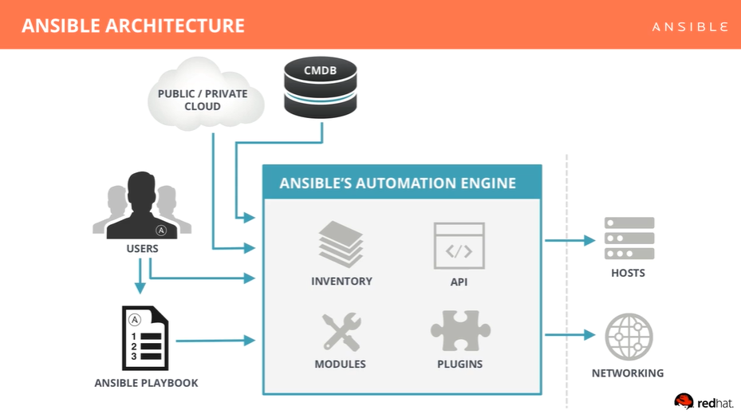
Architecture

Slide 7
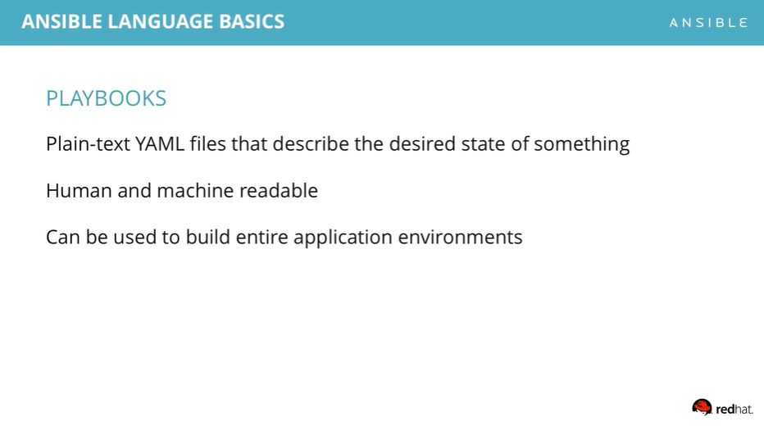
playbooks

Slide 8
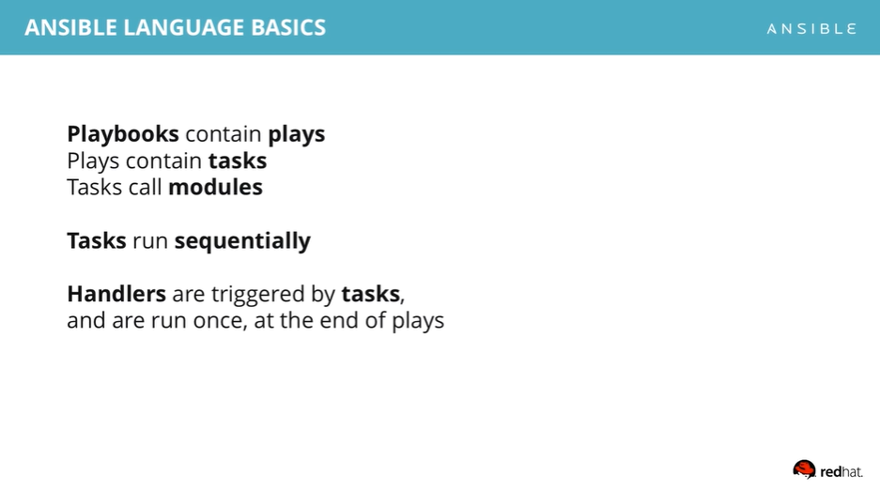
playbooks

Slide 9
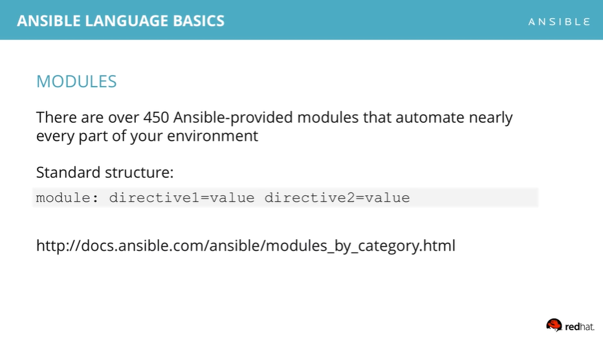
modules

Slide 10
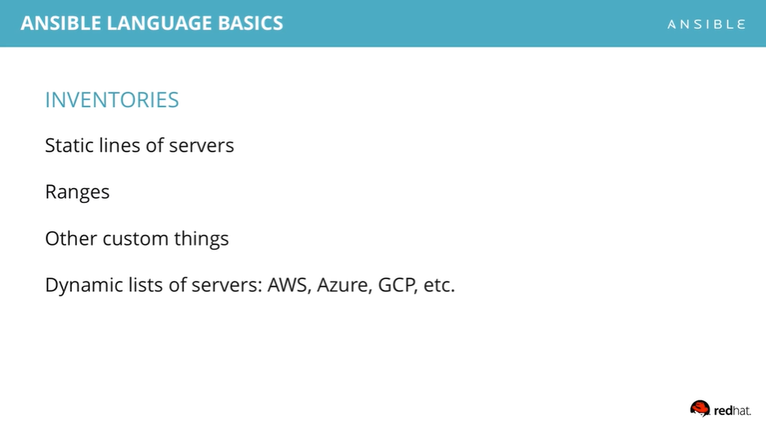
inventories

Slide 11

Ansible and windows

Slide 12
Ansible playbooks for windows
Demo

Slide 13
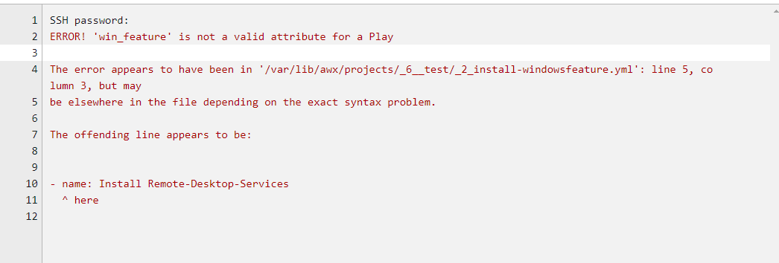
Gotchas
PowerShell Double-Hop CredSSP
Some cmdlets use New-PSSession without you knowing, e.g. some of the Remote Desktop Services module
YAML is pretty sensitive to syntax layout, e.g. spaces

Slide 14
Summary
https://www.ansible.com/resources/videos/quick-start-video
https://docs.ansible.com/ansible/latest/modules/list_of_windows_modules.html

